Slide 1
AI-Systems Learning in a DBMS (Database Management System)
Joseph E. Gonzalez
Co-director of the RISE Lab jegonzal@cs.berkeley.edu

Slide 2
Why are we starting with Machine Learning in Database Systems?

Slide 3
Why do ML in a Database System
Proximity to Data: minimize data movement
Avoid data duplication → inconsistency
Optimized for Data: database systems are optimized for efficient access and manipulation of data.
Data layout, buffer management, indexing, …
Normalization can improve performance
Schema information can help in modeling
Predictions with Data: trained models often used with data in the database.
Incorporate predictions into SQL queries
Security: control who and what models have access to what data
leverage existing access control lists (ACLs)

Slide 4
Challenges of Learning in Database
Abstractions: How does database expose data to alg.?
Some algorithms are a natural fit for existing abstractions
Access Patterns: How does algorithm access data?
Sequentially, randomly, repeated scans
Cost Models and Learning: How does database system aid in optimizing learning algorithm execution?
Exposing a broader set of trade-offs
Data Types: Does data fit in the relational models?
Images, video, models

Slide 5
Database Systems and ML
Database Systems supporting “Learning”
Data mining techniques heavily studied in DB community
Apriori algorithm for frequent item set (VLDB’94), widely cited
BIRCH large-scale clustering alg. (SIGMOD’96)
Most database systems have support for analytics and ML
Often specialized for particular techniques (e.g., SVM, decision tree,…)
“Learning” for Database Systems (Later in Semester)
Cardinality estimation using statistical models
Dynamic programming for query optimization
Recent excitement around RL + Deep Learning in databases

Slide 6
Objectives For Today
Review (some) Concepts in Database Systems
Relational Model
Data Independence
User defined aggregates
Out of core computation and latencies
Grace Hash Join Example
This Weeks Reading
Review big ideas in each paper
Key technical details
What to look for when reading

Slide 7
Big Ideas in Database Systems

Slide 8
Relational Database Systems
Logically organize data in relations (tables)
Sales relation:
Name | Prod | Price
Sue | iPod | $200.00
Joey | Bike | $333.99
Alice | Car | $999.00
Describes relationship:
Name purchased Prod at Price.
Tuple (row)
How is data physically stored?
Attribute (column)

Slide 9
Relational Data Abstraction
Database Management System
Relations (Tables)
Optimized Data Structures
Name | Prod | Price
Sue | iPod | $200.00
Joey | Bike | $333.99
Alice | Car | $999.00
B+Trees
sid | sname | rating | age
28 | yuppy | 9 | 35.0
31 | lubber | 8 | 55.5
44 | guppy | 5 | 35.0
58 | rusty | 10 | 35.0
Abstraction
Page 1
Page 2
Optimized Storage
bid | bname | color
101 | Interlake | blue
102 | Interlake | red
104 | Marine | red
103 | Clipper | green
Page 3
Page 4
Page Header
Page 5
Page 6

Slide 10
Relational Data Abstraction
Physical Data Independence:
Database management systems hide how data is stored from end user applications
→ System can optimize storage and computation without changing applications.
Database Management System
Relations (Tables)
Optimized Data Structures
Name | Prod | Price
Sue | iPod | $200.00
Joey | Bike | $333.99
Alice | Car | $999.00
B+Trees
sid | sname | rating | age
28 | yuppy | 9 | 35.0
31 | lubber | 8 | 55.5
44 | guppy | 5 | 35.0
58 | rusty | 10 | 35.0
Abstraction
Big Idea in Data Structures
Page 1
Page 2
Optimized Storage
bid | bname | color
101 | Interlake | blue
102 | Interlake | red
104 | Marine | red
103 | Clipper | green
Data Systems &
Computer Science
Page 3
Page 4
Page Header
Page 5
Page 6

Slide 11
Physical Data Independence
Physical data layout/ordering is determined by system
goal of maximizing performance
Data Clustering
Organize group of records to improve access efficiency
Example: grouped/ordered by key
Implications on Learning?
Record ordering may depend on data values
Arbitrary ordering ≠ Random ordering

Slide 12
Relational Database Systems
Logically organize data in relations (tables)
Structured Query Language (SQL) to define, manipulate and compute on data.
A common language used by many data systems
Describes logical organization of data as well as computation

Slide 13
SQL is a Declarative Language
Declarative: “Say what you want, not how to get it.”
Declarative Example: I want a table with columns “x” and “y” constructed from tables “A” and ”B” where the values in “y” are greater than 100.00.
Imperative Example: For each record in table “A” find the corresponding record in table “B” then drop the records where “y” is less than or equal to 100 then return the ”x” and “y” values.
Advantages of declarative programming
Enable the system to find the best way to achieve the result.
More compact and easier to learn for non-programmers (Maybe?)
Challenges of declarative programming
System performance depends heavily on automatic optimization
Limited language (not Turing complete) → need extensions

Slide 14
User Defined Aggregates
Provide a low-level API for defining functions that aggregate state across records in a table
Much like fold in functional Programming
CREATE AGGREGATE agg_name (…){
initialize(state) → state
transition(state, row) → state
terminate(state) → result
merge(state, state) → state
}
# Initialize the state for aggregation.
# Advance the state for one row. Invoked repeatedly.
# Compute final result.
# (Optional) Merge intermediate states from parallel executions.
Merge

Slide 15
Closed Relational Model and Learning
All operations on tables produce tables…
Training a model on a table produces?
A row containing a model
A table containing model weights
An (infinite) table of predictions
MauveDB: Supporting Model-based User Views in Database Systems
Predictions as views
Opportunity to index predictions
Relational operations to manipulate predictions

Slide 16
Out-of-core Computation
Database systems are typically designed to operate on databases larger than main memory (big data?)
Algorithms must manage memory buffers and disk
Page level memory buffers
Sequential reads/writes to disk
Understand relative costs of memory vs disk

Slide 17
Reasoning about Memory Hierarchy
Latency Numbers Every Programmer Should Know --Jeff Dean
L1 Cache
L2 Cache
Main Memory
Read 1MB from RAM (Seq.)
Read 1MB SSD (Seq.)
Read 1MB Disk (Seq.)
0.5 ns (few clock cycles)
7 ns
100 ns
250K ns
1M ns (1ms)
20M ns (20ms)
Notes:
https://gist.github.com/jhclark/2845836
1 ns = 10-9 seconds
1 ms = 10-3 seconds

Slide 18
Reasoning about Memory Hierarchy
Latency Numbers Every Programmer Should Know
Human Readable
L1 Cache 1 second
L2 Cache 14 seconds
Main Memory 3.3 minutes
Read 1MB from RAM (Seq.) 5.8 days
Read 1MB SSD (Seq.) 23 days
Read 1MB Disk (Seq.) 1.3 years
Database Systems
Page Buffers
Sequential
Read/Write
Notes:
https://gist.github.com/jhclark/2845836
1 ns = 10-9 seconds
1 ms = 10-3 seconds

Slide 19
Example Out-of-Core Alg.: Grace Hash Join

Slide 20
Grace Hash Join
R ⋈_{𝜃} S = 𝜎_{𝜃}( R × S)
Requires equality predicate 𝜃:
Works for Equi-Joins & Natural Joins
Two Stages:
Partition tuples from R and S by join key
all tuples for a given key in same partition
Build & Probe a separate hash table for each partition
Assume partition of smaller rel. fits in memory
Recurse if necessary…
Divide
Conquer

Slide 21
Grace Hash Join: Partition
R
S
B-1 Buffers
Partition 1
1 Buffer
Partition 2

Slide 22
Grace Hash Join: Partition
R
S
B-1 Buffers
Partition 1
1 Buffer
Partition 2

Slide 23
Grace Hash Join: Partition
R
S
B-1 Buffers
Partition 1
1 Buffer
Partition 2

Slide 24
Grace Hash Join: Partition
R
S
B-1 Buffers
Partition 1
1 Buffer
Partition 2

Slide 25
Grace Hash Join: Partition
R
S
B-1 Buffers
Partition 1
1 Buffer
Partition 2

Slide 26
Grace Hash Join: Partition
R
S
B-1 Buffers
Partition 1
1 Buffer
Partition 2

Slide 27
Grace Hash Join: Partition
R
S
B-1 Buffers
Partition 1
1 Buffer
Partition 2

Slide 28
Grace Hash Join: Partition
R
S
B-1 Buffers
Partition 1
1 Buffer
Partition 2

Slide 29
Grace Hash Join: Partition
R
S
B-1 Buffers
Partition 1
1 Buffer
Partition 2

Slide 30
Grace Hash Join: Partition
R
S
B-1 Buffers
Partition 1
1 Buffer
Partition 2

Slide 31
Grace Hash Join: Partition
R
S
B-1 Buffers
Partition 1
1 Buffer
Partition 2

Slide 32
Grace Hash Join: Partition
R
S
B-1 Buffers
Partition 1
1 Buffer
Partition 2

Slide 33
Grace Hash Join: Partition
R
S
B-1 Buffers
Partition 1
1 Buffer
Partition 2

Slide 34
Post Hash Partitioning
R
S
Observe how memory buffers are directly managed
Paged to disk when full …
Each key is assigned to one partition
e.g., green keys in partition1
Sensitive to key Skew
Fuchsia Key
Partition 1
Partition 2
1 Buffer
B-1 Buffers

Slide 35
Grace Hash Join: Build & Probe
Partition 1
Hash Table (B-2) Buffers
1 Buffer
1 Buffer
Partition 2
New Hash Fn.

Slide 36
Grace Hash Join: Build & Probe
Partition 1
Hash Table (B-2) Buffers
1 Buffer
1 Buffer
Partition 2
New Hash Fn.

Slide 37
Grace Hash Join: Build & Probe
Partition 1
Hash Table (B-2) Buffers
1 Buffer
1 Buffer
Partition 2
New Hash Fn.

Slide 38
Grace Hash Join: Build & Probe
Partition 1
Hash Table (B-2) Buffers
1 Buffer
1 Buffer
Partition 2
New Hash Fn.

Slide 39
Cost of Hash Join
R
S
B-1 Buffers
Hash Table (B-2) Buffers
Read
1 Buffer
Write
Read
?
1 Buffer
1 Buffer
Hash
New Hash Fn.
Partitioning Phase
Build & Probe Phase
Partitioning phase: read+write both relations
2([R]+[S]) I/Os
Matching phase: read both relations, forward output
[R]+[S]
Total cost of 2-pass hash join = 3([R]+[S])

Slide 40
Cost of Hash Join
R
S
B-1 Buffers
Hash Table (B-2) Buffers
Read
1 Buffer
Write
Read
?
1 Buffer
1 Buffer
Hash
New Hash Fn.
Partitioning Phase
Build & Probe Phase
Memory Requirements?
Build hash table on R with uniform partitioning
Partitioning Phase divides R into (B-1) runs of size [R] / (B-1)
Build Phase requires each [R] / (B-1) < (B-2)
R < (B-1) (B-2) ≈ B²

Slide 41
This weeks reading

Slide 42
Reading for the Week
Two Chris Ré Papers.
One of the leaders in DB+ML research
Towards a Unified Architecture for in-RDBMS Analytics
SIGMOD’12,
Support generic learning within existing DBMS abstraction
Materialization Optimizations for Feature Selection Workloads
SIGMOD’14 (Best Paper)
Optimize feature engineering workloads by exploiting redundancy
Learning Generalized Linear Models Over Normalized Data
SIGMOD’15
Pushing learning through joins on normalized data
Note these are “older” papers but they cover big ideas

Slide 43
Towards a Unified Architecture for in-RDBMS Analytics
Xixuan Feng, Arun Kumar, Benjamin Recht, and Christopher Ré

Slide 44
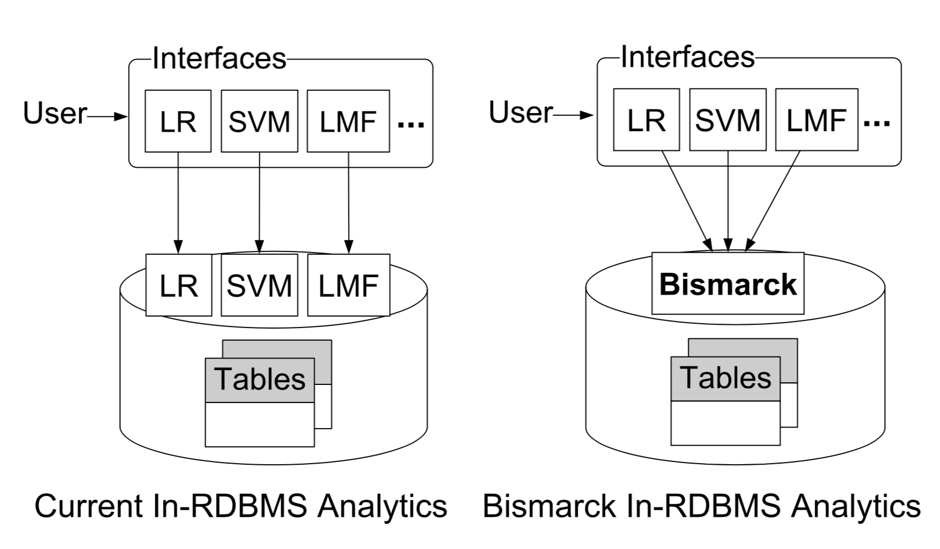
Towards a Unified Architecture for in-RDBMS Analytics
Context: database system vendors building specialized in DB implementations of ML techniques.
Slow and costly to add support for new models/algorithms
Many ML techniques leverage (convex) empirical risk minimization
Key Idea: Many ML techniques can be reduced to mathematical programming and there is a single solver (IGD) that fits existing database system abstractions (UDAs)
Contribution: this paper demonstrates the advantages of leveraging existing optimized abstractions for learning

Slide 45
Challenges Addressed
Mapping IGD to User Defined Aggregates (UDA)
Affects of data ordering on convergence
Data often stored in a pathological ordering (e.g., by label)
Parallelization of Incremental Algorithm
Adopt two standard solutions (model averaging, Hogwild!)

Slide 46
What is the difference between Incremental vs Stochastic Gradient Descent?
Short Answer: Stochastic gradient descent is a form of incremental gradient descent
Incremental Gradient Descent
Formally: taking single gradient steps for each element of a decomposable loss
Ordering of gradient terms is arbitrary
Stochastic Gradient Descent
Formally: sampling from the gradient of the empirical loss
Sample data and compute gradient of loss on sample
Today people often refer to incremental gradient methods as stochastic gradient descent
Incremental Gradient, Subgradient, and Proximal Methods for Convex Optimization: A Survey

Slide 47
Mapping IGD to User Defined Aggregates (UDA)
CREATE AGGREGATE bismarck (…){
initialize(args) → state:
randomly initialize model weights
transition(state, row) → state:
single gradient update
terminate(state) → result
return current model for epoch
merge(state, state) → state
used for parallel model averaging
}
State contains:
Model weights, k, …
Invoked repeatedly
Once per epoch
Bismarck stored procedure
Termination cond.
Similar to IGD

Slide 48
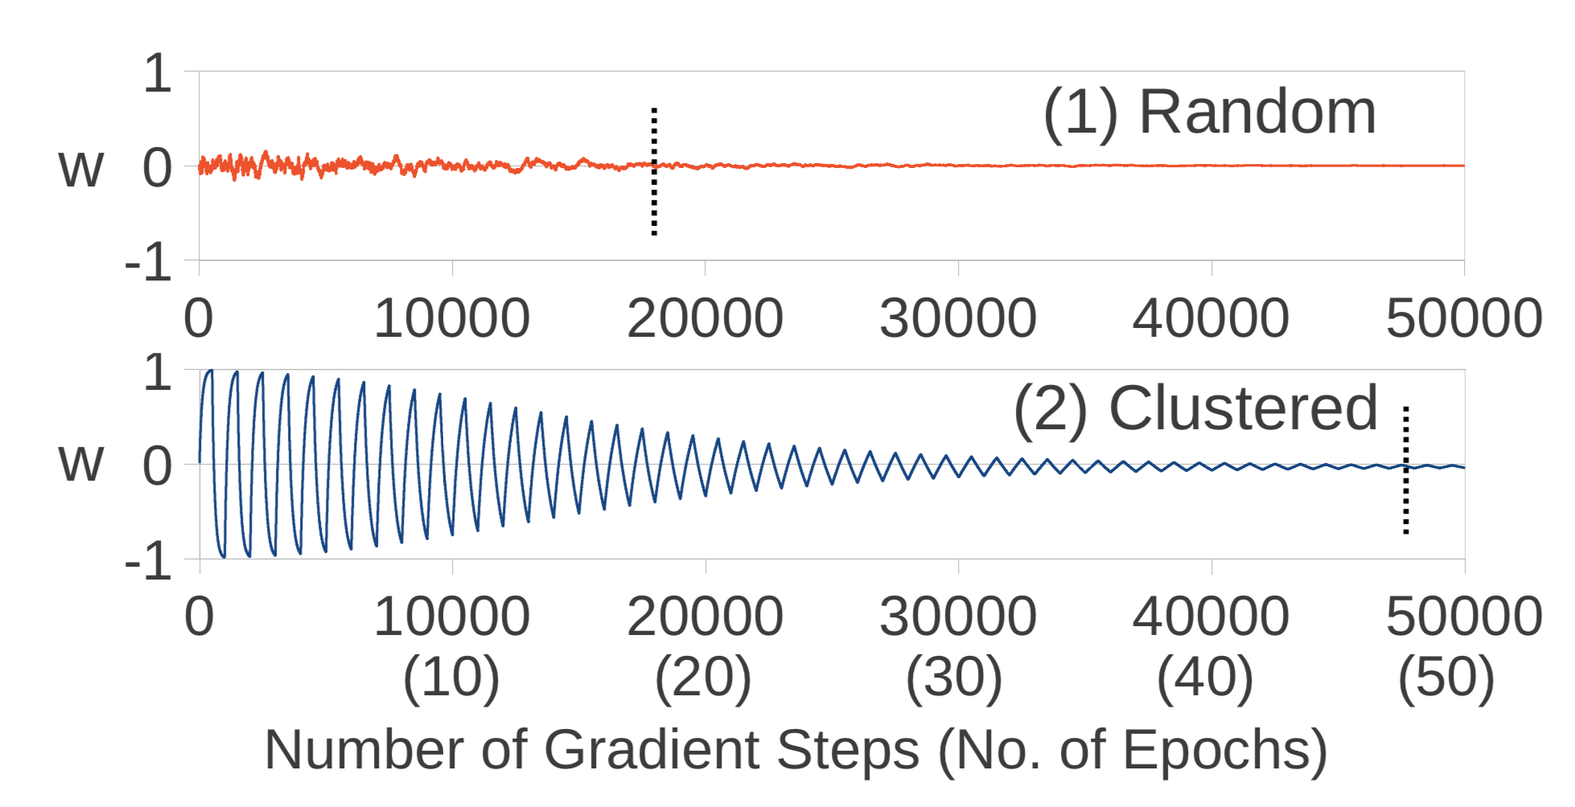
Data Ordering Issues
Data indexed/clustered on key feature or even the label
Example: predicting customer churn → data is partitioned by active customers and cancelled customers
Why?
May slow down convergence:
Random Order
Sorted by label

Slide 49
Data Order Solutions
Shuffle data
on each epoch (pass through data): Closest to stochastic gradient alg.
Expensive data movement and duplication
Once: good compromise but requires data movement and dup.
Sample data
single reservoir sample per pass
Train on less data per scan → slower convergence
multiplexed reservoir sampling
Concurrently training on sample and raw data streams

Slide 50
Parallelization
Pure UDA Version: Primal (model) averaging
leverage merge operation
Appeals to result by Zinkevich* (requires iid data, convex loss, …)
Doesn’t work as well in practice
Shared Memory UDA*
Consistent (Atomic IG): atomic compare and swap for updates
Consistent but limited parallelism + bus traffic and branch misses
No locks (Hogwild!™): write to memory and allow races
Word writes within cache lines are atomic (either old or new version wins)
*Implications on distributed databases?
*Parallelized Stochastic Gradient Descent

Slide 51
Hogwild! Algorithm
Shared Memory
Thread 1
Thread 2
Thread 3
Data
Partition
Data
Partition
Data
Partition

Slide 52
Hogwild! Algorithm
Shared Memory
Write
Thread 1
Thread 2
Thread 3
Data
Partition
Data
Partition
Data
Partition

Slide 53
Hogwild! Algorithm
Shared Memory
Write
Thread 1
Thread 2
Thread 3
Data
Partition
Data
Partition
Data
Partition

Slide 54
Hogwild! Algorithm
Shared Memory
Write
Write
Thread 1
Thread 2
Thread 3
Data
Partition
Data
Partition
Data
Partition

Slide 55
Hogwild! Algorithm
No corrupted floats:
Individual entries are consistent.
Shared Memory
Inconsistent read
Thread 1
Thread 2
Thread 3
Data
Partition
Data
Partition
Data
Partition

Slide 56
What to think about when reading?
Implications in contemporary deep learning setting
TF/Pytorch training in PostgreSQL?
Implications on distributed training?
Multiplexed Reservoir Sampling
Relationship to Replay Buffers in RL
Could we leverage idea to mitigate data load to GPU?

Slide 57
Materialization Optimizations for Feature Selection Workloads
Ce Zhang, Arun Kumar, Christopher Ré

Slide 58
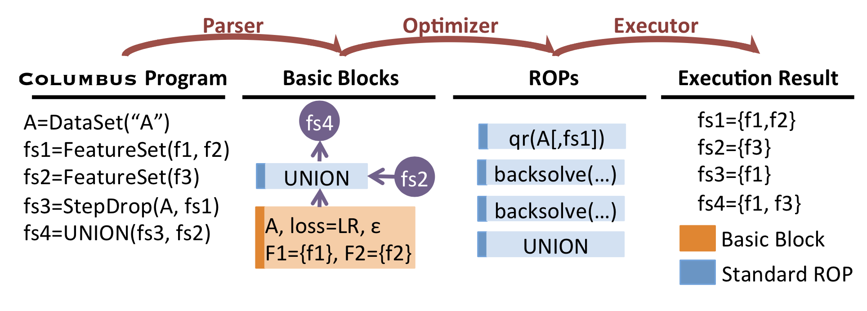
Materialization Optimizations for Feature Selection Workloads
Context: feature selection using R scripts dominate machine learning workloads → substantial opportunity for reuse!
Key Idea: Rich tradeoff space of what to materialize, how to leverage sampling, and reuse computation
Contribution: this paper demonstrates the advantages of exploring the tradeoff space and describes ways in which various operations interact.

Slide 59
Problem Formulation
Data
Solve multiple problems for subsets of rows and columns of original data
Block consists of:
Loss functions L
Set of Sets of Rows / Columns
Accuracies ϵ
Explore optimizations targeted at solving the related problems
Materialization, Sampling, Compute reuse
 | f₁ | f₂ | f₃ | f₄ | f₅
r₁
r₂
r₃
r₄
b
A =
b =
Generalized Linear Model
Solve (within ϵ of optimum)
Projection Matrix
For each t:
0
1
1
0
0
1
0

Slide 60
Optimization: Lazy vs Eager Materialization
Lazy Materialization: construct each feature table as it is needed from raw data
Eager Materialization: precomputes the superset of columns (features) and then projects away what is not needed for each optimization task
Tradeoffs
Lazy → Higher computational cost, less storage overhead
Eager → Less compute, greater storage overhead

Slide 61
Optimization: Sampling
No Sampling: compute on full data
May waste computation when identifying features
Random Sampling: work on random subset of data (rows)
Much faster but potentially less accurate conclusions
Coreset Sampling: weighted sampling to improve approximation of loss estimate
Better captures outliers
Requires multiple passes through data and rows >> columns

Slide 62
Optimization: Compute Reuse
QR Factorization: reuse computation across multiple solves of related linear systems
Clever (established) idea
Limited applicability squared loss + linear models + L₂ regularization
Example Regularized Least Squares:
Loss minimizer is the solution to:
Solved O(d³)
Reuse:
and
Solved O(d²) using backward substitution:
=
for any
Specific to squared loss + linear model

Slide 63
Optimization: ADMM + Warmstart
ADMM Alg.: rewrite more general convex optimization problems (e.g., LASSO, logistic regression, SVM) into sequence of least squares problems (leverage QR)
Clever (established) idea
Enables use of warm-start
Repeatedly Solve Least Squares Problem (use QR technique)
Extra hyperparameter
O(n) one-dimensional optimization problems
Specific to squared loss + linear model

Slide 64
What consider when reading?
Problem formulation and discussion around user interviews
Discussion and framing of tradeoffs
Would these techniques be applicable beyond feature selection (e.g., hyperparameter search/model design)?

Slide 65
Learning Generalized Linear Models Over Normalized Data
Arun Kumar, Jeffrey Naughton, and Jignesh M. Patel

Slide 66
Learning Generalized Linear Models Over Normalized Data
Context: Training data is often heavily denormalized resulting in substantial redundancy.
increases storage and data load time and computation
Key Idea: Push learning through joins to eliminate redundant loads and inner product calculations
Contribution: this paper demonstrates the advantages of pushing learning through joins
Done using UDA abstractions

Slide 67
Context: Unnormalized Data
pname | category | price | qty | date | day | city | state | country
Corn | Food | 25 | 25 | 3/30/16 | Wed. | Omaha | NE | USA
Corn | Food | 25 | 8 | 3/31/16 | Thu. | Omaha | NE | USA
Corn | Food | 25 | 15 | 4/1/16 | Fri. | Omaha | NE | USA
Galaxy | Phones | 18 | 30 | 1/30/16 | Wed. | Omaha | NE | USA
Galaxy | Phones | 18 | 20 | 3/31/16 | Thu. | Omaha | NE | USA
Galaxy | Phones | 18 | 50 | 4/1/16 | Fri. | Omaha | NE | USA
Galaxy | Phones | 18 | 8 | 1/30/16 | Wed. | Omaha | NE | USA
Peanuts | Food | 2 | 45 | 3/31/16 | Thu. | Seoul |  | Korea
Galaxy | Phones | 18 | 100 | 4/1/16 | Fri. | Seoul |  | Korea
Big table: many columns and rows
Substantial redundancy → expensive to store and access
Make mistakes while updating
Could we organize the data more efficiently?
Notes:
Why would we want to normalize? Let’s say we wanted to change the price of an item…SQL queries can get really messy and expensive when you have a lot of repeated data.

Slide 68
Multidimensional Data Model
Sales Fact Table
Locations
pid | timeid | locid | sales
11 | 1 | 1 | 25
11 | 2 | 1 | 8
11 | 3 | 1 | 15
12 | 1 | 1 | 30
12 | 2 | 1 | 20
12 | 3 | 1 | 50
12 | 1 | 1 | 8
13 | 2 | 1 | 10
13 | 3 | 1 | 10
11 | 1 | 2 | 35
11 | 2 | 2 | 22
11 | 3 | 2 | 10
12 | 1 | 2 | 26
12 | 2 | 2 | 45
12 | 3 | 2 | 20
13 | 1 | 2 | 20
13 | 2 | 2 | 40
13 | 3 | 2 | 5
locid | city | state | country
1 | Omaha | Nebraska | USA
2 | Seoul |  | Korea
5 | Richmond | Virginia | USA
Dimension
Tables
Products
Fact Table
Minimizes redundant info
Reduces data errors
Dimensions
Easy to manage and summarize
Rename: Galaxy1 → Phablet
Normalized Representation
How do we do analysis?
Joins!
pid | pname | category | price
11 | Corn | Food | 25
12 | Galaxy 1 | Phones | 18
13 | Peanuts | Food | 2
Time
timeid | Date | Day
1 | 3/30/16 | Wed.
2 | 3/31/16 | Thu.
3 | 4/1/16 | Fri.

Slide 69
The Star Schema
Products
Time
pid | pname | category | price
timeid | Date | Day
Sales Fact Table
pid | timeid | locid | sales
← This looks like a star …
Locations
locid | city | state | country
Notes:
Collection of tables with the fact table at the center and a variety of key relationships.

Slide 70
Multidimensional Data Model
Sales Fact Table
Locations
pid | timeid | locid | sales
11 | 1 | 1 | 25
11 | 2 | 1 | 8
11 | 3 | 1 | 15
12 | 1 | 1 | 30
12 | 2 | 1 | 20
12 | 3 | 1 | 50
12 | 1 | 1 | 8
13 | 2 | 1 | 10
13 | 3 | 1 | 10
11 | 1 | 2 | 35
11 | 2 | 2 | 22
11 | 3 | 2 | 10
12 | 1 | 2 | 26
12 | 2 | 2 | 45
12 | 3 | 2 | 20
13 | 1 | 2 | 20
13 | 2 | 2 | 40
13 | 3 | 2 | 5
locid | city | state | country
1 | Omaha | Nebraska | USA
2 | Seoul |  | Korea
5 | Richmond | Virginia | USA
Dimension
Tables
Products
Dimension tables contain feature information
Idea: Compute/store feature transformations for dimension tables?
pid | pname | category | price
11 | Corn | Food | 25
12 | Galaxy 1 | Phones | 18
13 | Peanuts | Food | 2
Time
timeid | Date | Day
1 | 3/30/16 | Wed.
2 | 3/31/16 | Thu.
3 | 4/1/16 | Fri.
Notes:
Normalization does not refer to statistical normalization – if you want to learn more, take CS 186. There are many forms of normalization, but we won’t cover that here.

Slide 71
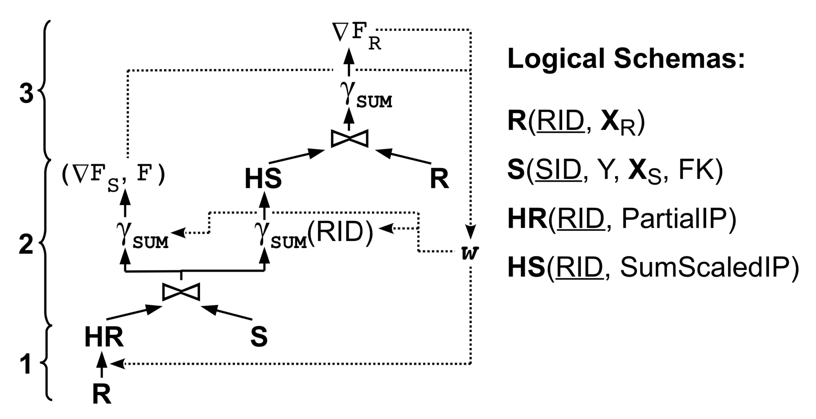
Factorize Algorithm
SID | Y | X_{S} | RID
RID | X_{R}
R
S
Compute partial inner products with features in R → HR
Join HR with S
Finish computing inner products
Aggregate sum of loss F
Aggregate gradient of loss for S weights
Group join result on RID (foreign key)
Aggregate gradients on S
Join aggregated gradients with R
Aggregate gradient of loss for R weights

Slide 72
Factorize Algorithm
SID | Y | X_{S} | RID
RID | X_{R}
R
S
Compute partial inner products with features in R → HR
Join HR with S
Finish computing inner products
Aggregate sum of loss F
Aggregate gradient of loss for S weights
Group join result on RID (foreign key)
Aggregate gradients on S
Join aggregated gradients with R
Aggregate gradient of loss for R weights

Slide 73
Factorize Algorithm
SID | Y | X_{S} | RID
RID | X_{R}
R
S
Compute partial inner products with features in R → HR
Join HR with S
Finish computing inner products
Aggregate sum of loss F
Aggregate gradient of loss for S weights
Group join result on RID (foreign key)
Aggregate gradients on S
Join aggregated gradients with R
Aggregate gradient of loss for R weights

Slide 74
Factorize Algorithm
SID | Y | X_{S} | RID
RID | X_{R}
R
S
Compute partial inner products with features in R → HR
Join HR with S
Finish computing inner products
Aggregate sum of loss F
Aggregate gradient of loss for S weights
Group join result on RID (foreign key)
Aggregate gradients on S
Join aggregated gradients with R
Aggregate gradient of loss for R weights

Slide 75
Thoughts For Reading
Emphasis on cost model
Can you work through the cost calculations?
What would happen if features depended on cross terms between tables?
Would these techniques be applicable beyond feature selection (e.g., hyperparameter search/model design)?
Are there scenarios where this optimization would work?

Slide 76
Done!

